Slide 1
University of Diyala /
College of Education for
Humanities
Asst. Inst. Eman Ahmed
Second Grade
Tenth Lecture
Classroom Managements
ALLPPT.com _ Free PowerPoint Templates, Diagrams and Charts

Slide 2
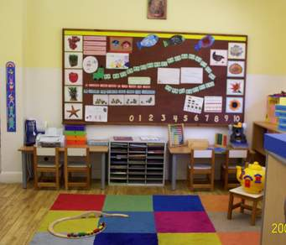
What is classroom management?
Classroom managements refer to the
way the teacher organize what goes in the classroom.

Slide 3
How Can EFL/ESL Teachers Use Knowledge of Classroom Management to Create Opportunities for Students to Interact in English in Meaningful Ways?
This section discusses how teachers manage classroom teaching so that students have
opportunities to interact in English in
meaningful ways.

Slide 4
Teacher Talk
When asked to tape-record their teaching, listen to the tape, and total the amount of time they talk, teachers are generally surprised to discover they spend much more time talking than they had imagined.

Slide 5
The Teacher’s Questions
Teachers ask a lot of questions. For example, in a study of the frequency of questions asked by elementary school teachers in the United States, Nash and Shiman discovered teachers ask between 45 and 150 questions every half hour.

Slide 6
The purpose of Teachers’Questions
1-Display questions.
2-Referential questions.
3-Comprehension check.
4-Conformation questions.
5-Clarification questions.

Slide 7
The Content of Teachers Questions
1-Study of language.
2-Study of subject.
3-Procedure.
4-Life-General.
5-Life Personal.

Slide 8
Thank You

